Slide 1
Farm Tower
Innovating way of agriculture
Notes:
intro

Slide 2
Agriculture land uses
.
Livestock.
34%
03
Arable Farming.
01
Pasture-land.
About 34% of Earth’s landmass are being used for agriculture that include arable farming, pastureland and livestock.
02
Notes:
Nowadays farmland

Slide 3
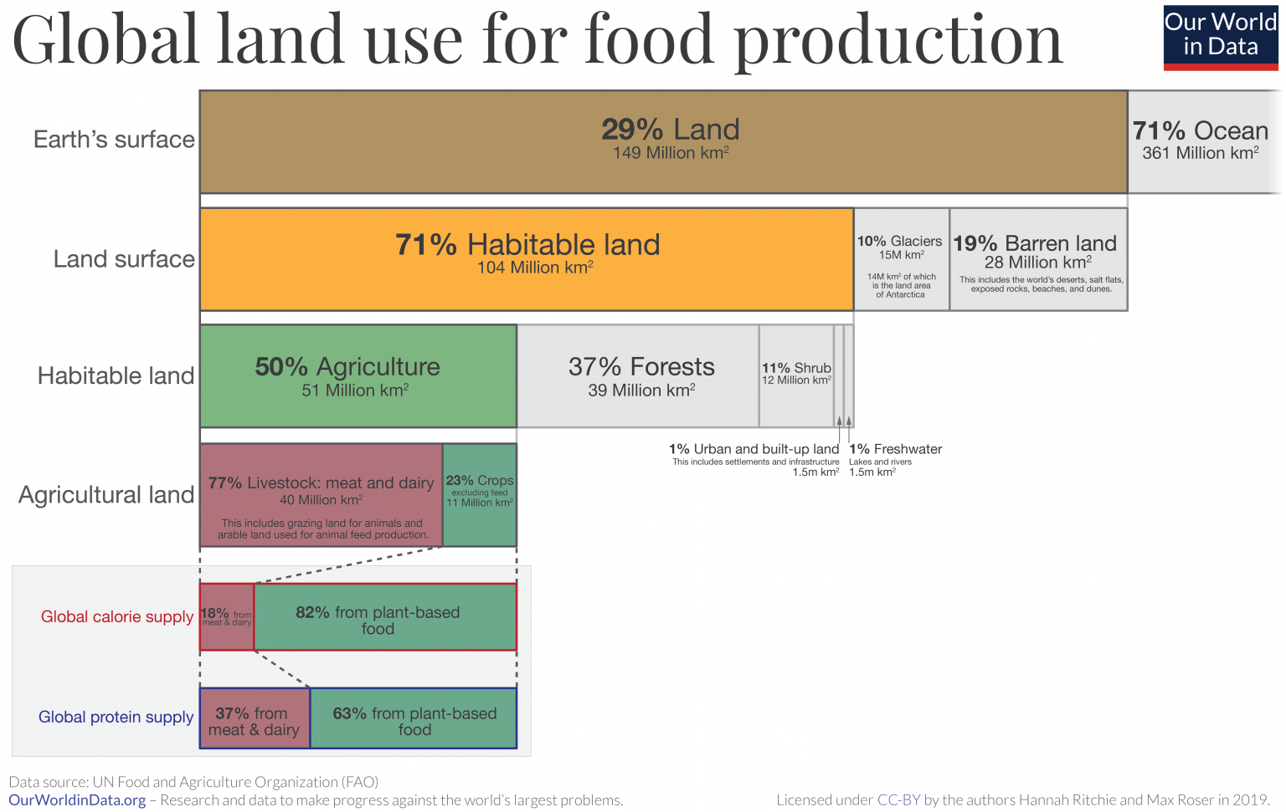
Land use
Notes:
Model of the tower

Slide 4

Arable farming
Livestock production
Pastureland
Land use for agriculture
Notes:
Farmland and pasture use

Slide 5
Indirect Problem
01
02
03
04
Ineffective
Overcrowded
Collection
Felling
Land are being use with little production and a lot of human power.
Each farmland are too far apart that hard to distribute.
Trees are being cut down to make space for farmland.
Cities are having too much population.
Notes:
Problem it created

Slide 6
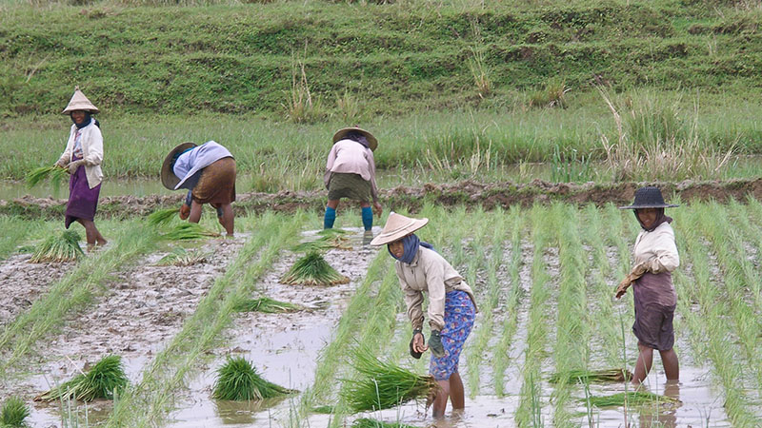
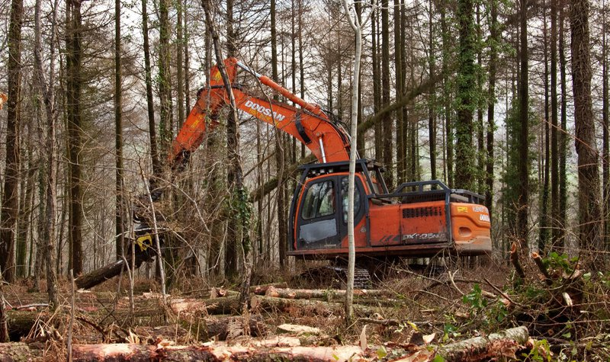
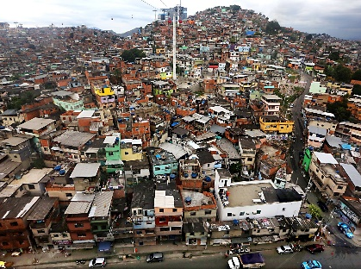
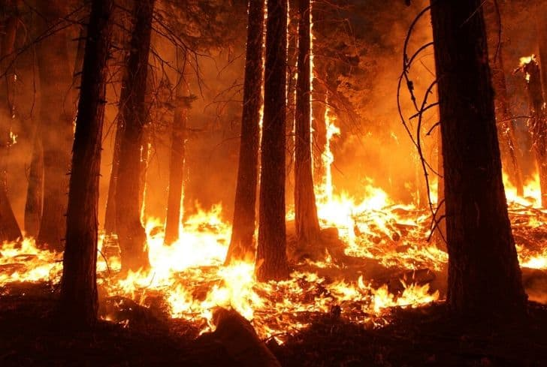
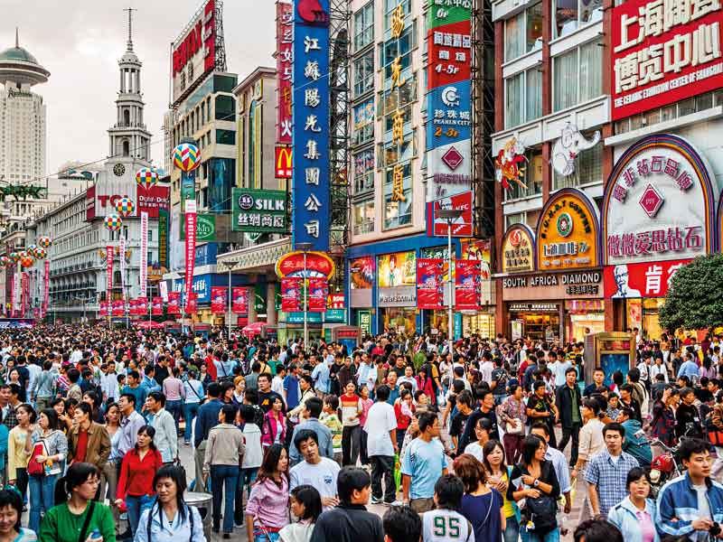
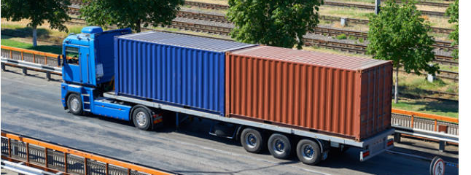
Problem
Many of the problem are seen around us, and some of them are directly or indirectly cause by ineffective land use.
Notes:
Picture of the problem

Slide 7
Model

Slide 8
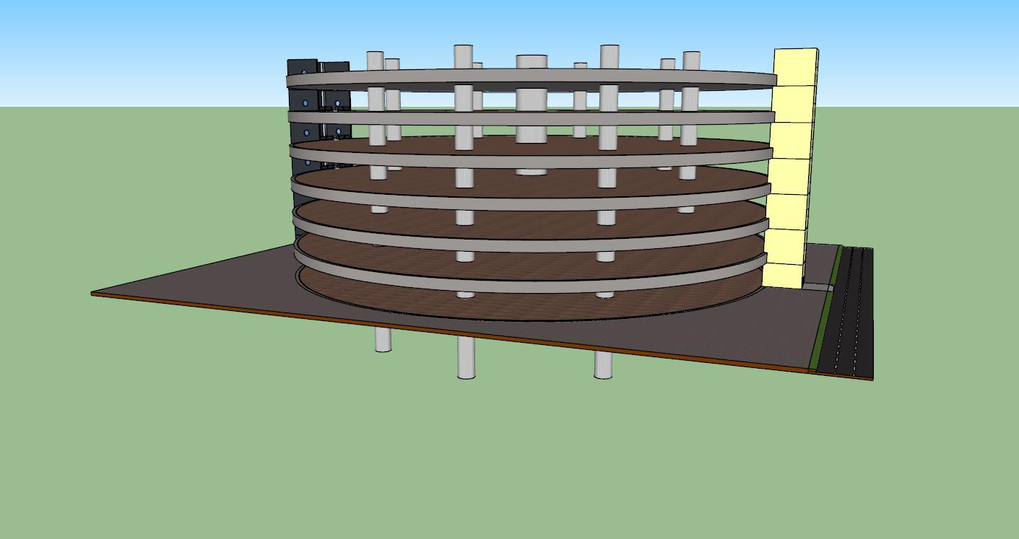
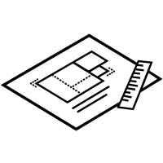
Blueprint Designed
Notes:
Model of the tower

Slide 9
Advantages
Distribution
Common workplace
With a transportation truck, it can transfer massive of numbers product in the same place easily.
Organizations can run this tower for producing crops without a lot of negotiation.
Space saving
Reinforcement
Consistence production
Obviously, the more floor this tower has, the more time the space are saved.
With an improvement of technology, agriculture also need to be improve.
Production of the farm can be more consistence and not depend on the weather.
Notes:
What has it solve

Slide 10
Thank You
Research by: Tith Bunnath

